Slide 1

Grand Finale! NO CHANGES ALLOWED. DEADLINE WAS ON May 19th.
Minute Madness Presentation!

Slide 2



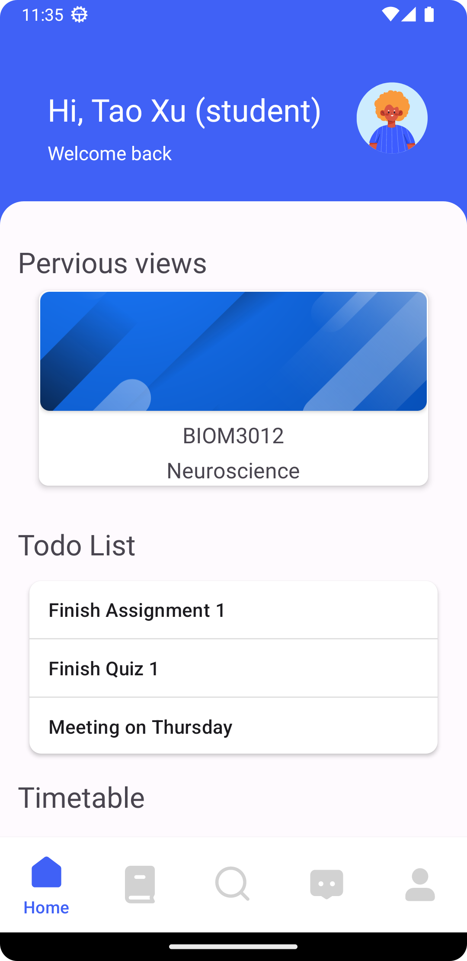
GROUP Learniverse (Group 66)
GROUP Learniverse (Group 66)
Group members |
Tao Xu (u7546928)*
Ziyang Feng (u7517105)
Zeyi Wu (u7464326)
Mengfan Yan (u7375900)
Junhao Wang (u7375013)
*presenter(s)

Slide 3
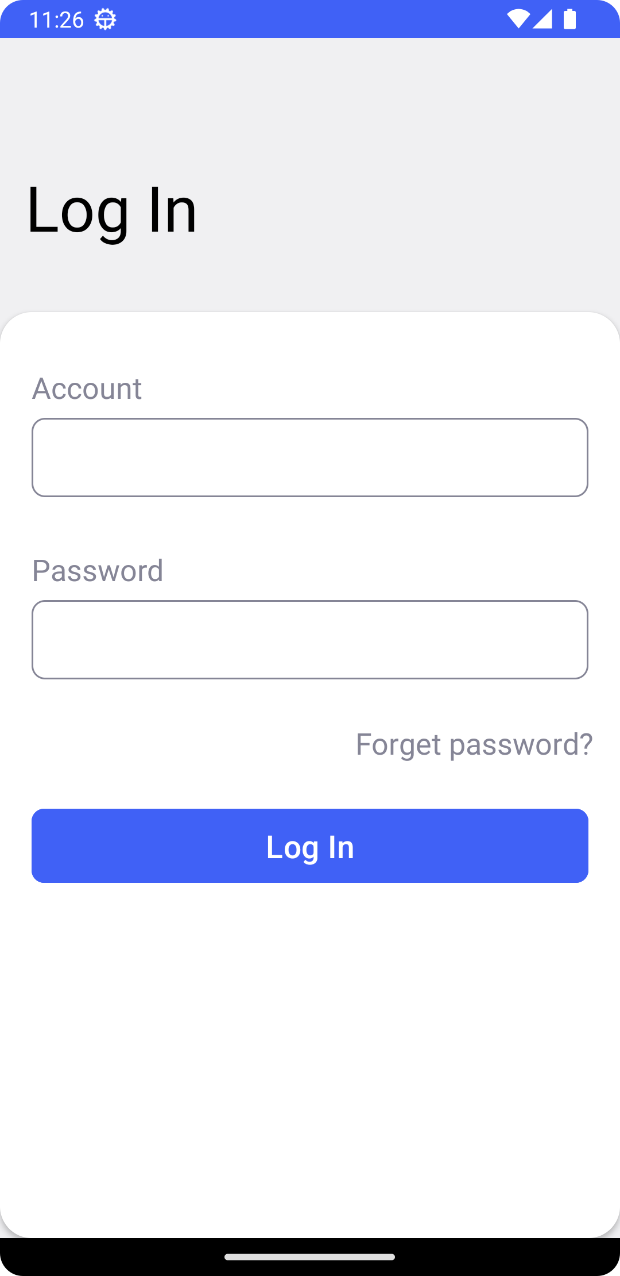
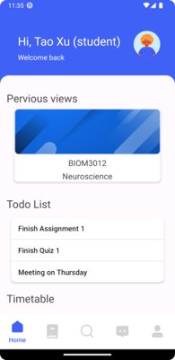
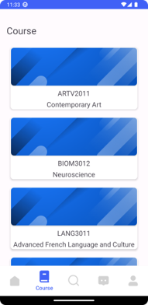
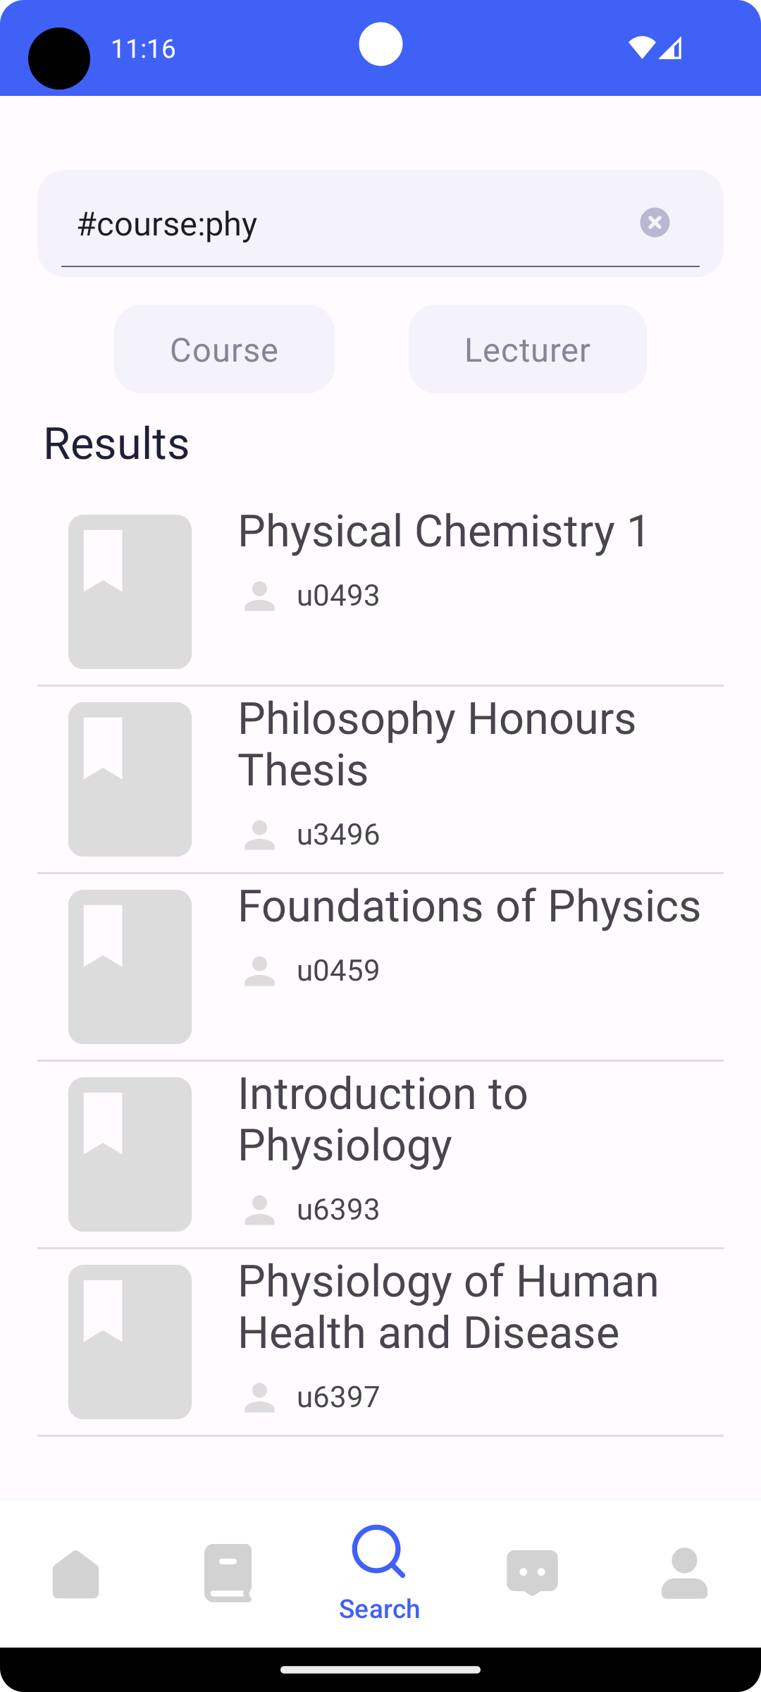
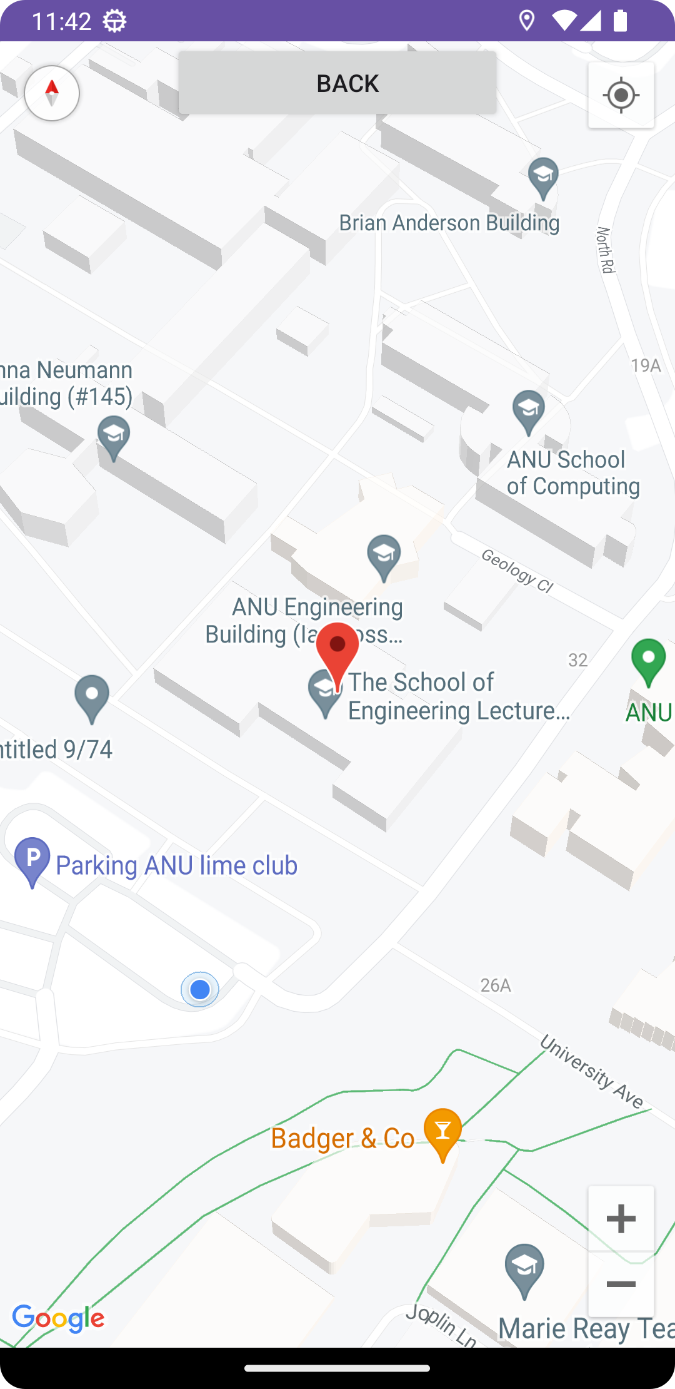
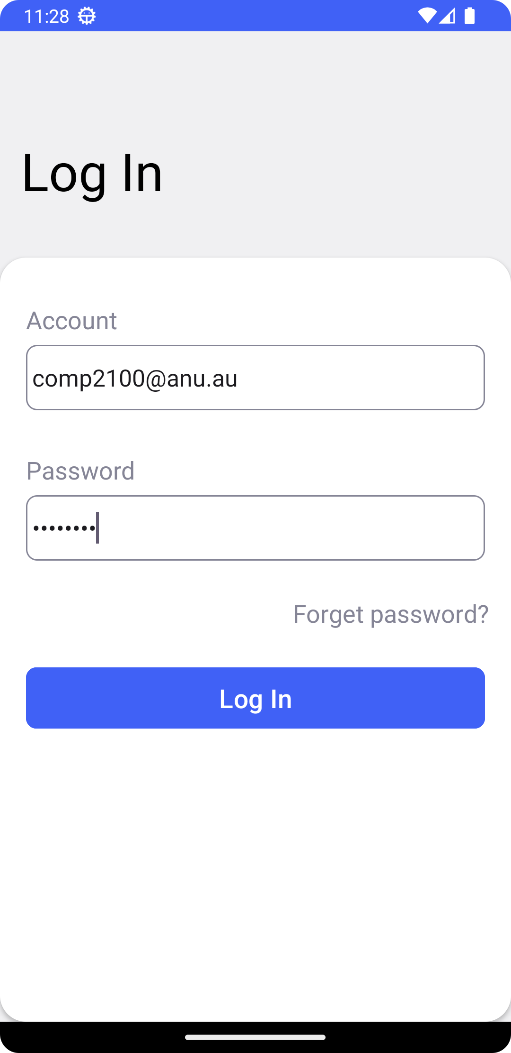
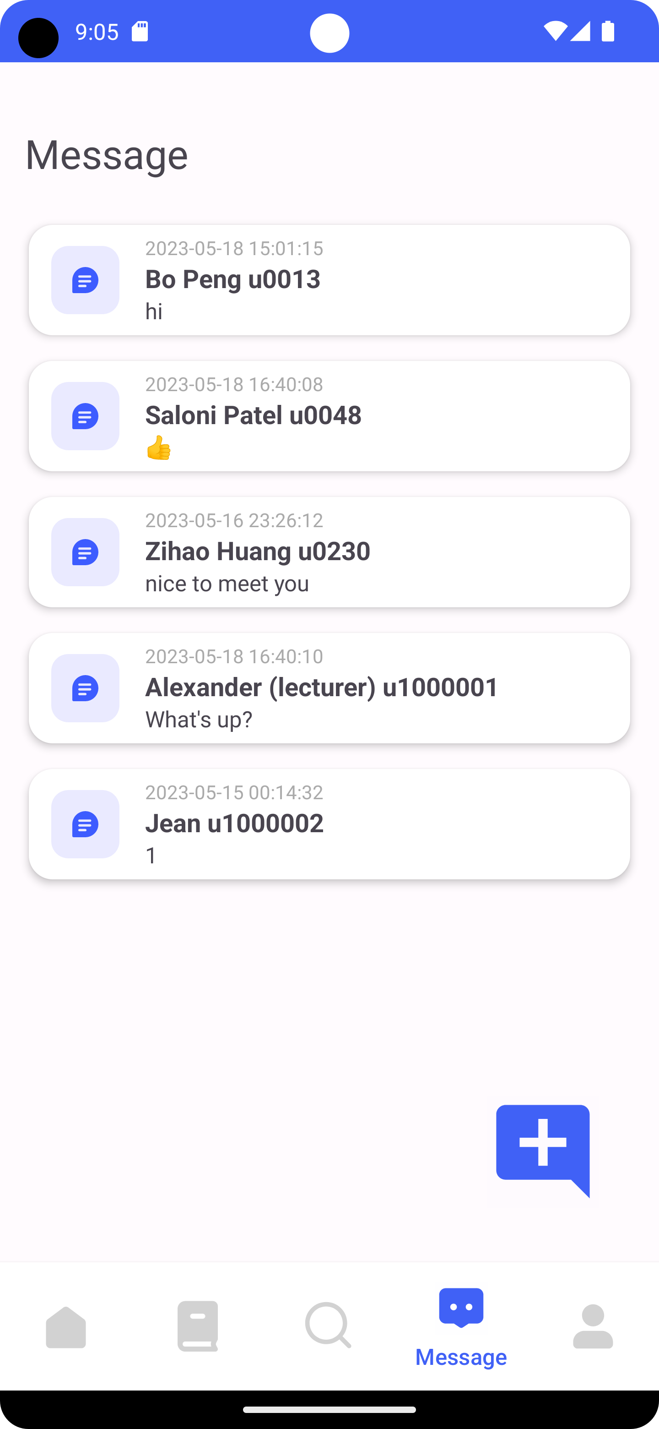
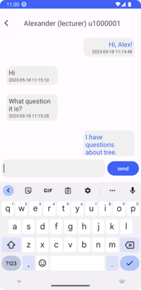
Project Overview
Project Overview
The learning platform to enhance student and lecturer's experience
Platform to Learn
Course to
Find
People to
Ask
1/3

Slide 4
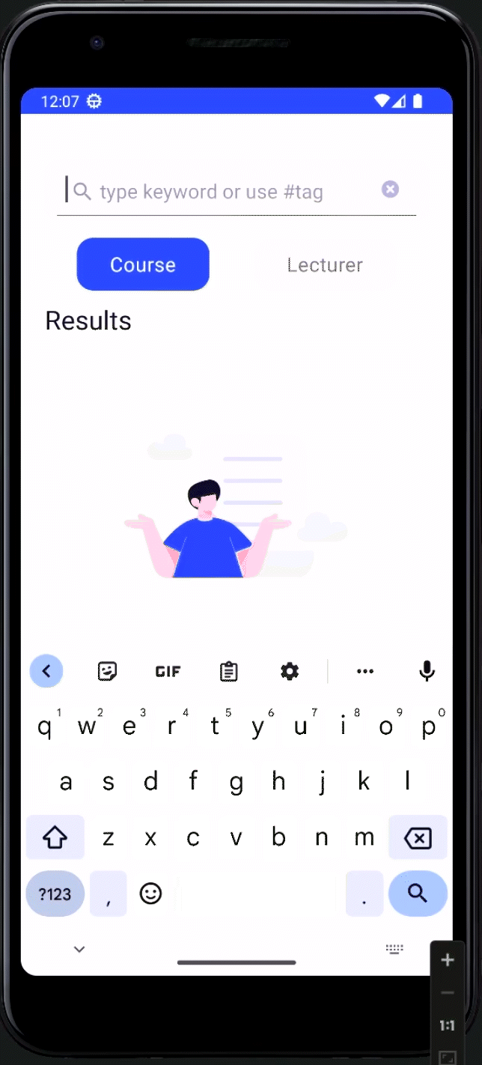



Tech Spaces​
Tech Spaces​
Learniverse
Fuzzy searching with the filter​
AVL tree is used to search for other users
Firebase Realtime Listener for real-time synchronization
2/3

Slide 5



Other Features
Other Features
[Search-Invalid]
[Search-Filter]
[UI-Layout]
[Data-Profile]
[Data-GPS]
[P2P-DM]
[FB-Auth]
[FB-Persist]
[FB-Syn]
Factory Pattern
State Pattern
Singleton Pattern
3/3

